Slide 1
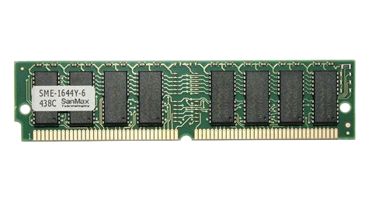
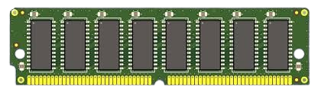
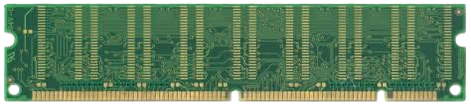
Simm vs rimm
SIMM A SIMM (Single Inline Memory Module) is an older type of computer memory module with a single row of connectors. It was used primarily in the 1980s and 1990s for adding RAM.
Fig: SIMM
SIM V/S RIMM
By Aashish Subedi
aashishsubedi478@gmail.com
Fig: RIMM

Slide 2
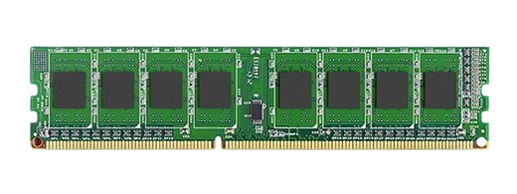

Stands for Single In-line Memory Module
It supports 32 bit channel for data transfer
Commonly it has 72 pins
Fig: SIMM
SIMM A SIMM (Single Inline Memory Module) is an older type of computer memory module with a single row of connectors. It was used primarily in the 1980s and 1990s for adding RAM.
It is an old technology

Slide 3
DIMM A DIMM (Dual Inline Memory Module) is a modern type of computer memory module with connectors on both sides. It has a higher capacity and better performance compared to SIMMs, making it the standard choice for adding RAM in today's computers.
Full Form
Dual In-line Memory Module
Supporting Chanel
It supports 64 bit channel for data transfer
Pins counting
In common it has 168 pins.
Generation
In common it has 168 pins.
Fig: DIMM

Slide 4

Aashish Subedi
aashishsubedi478@gmail.com

